Slide 1
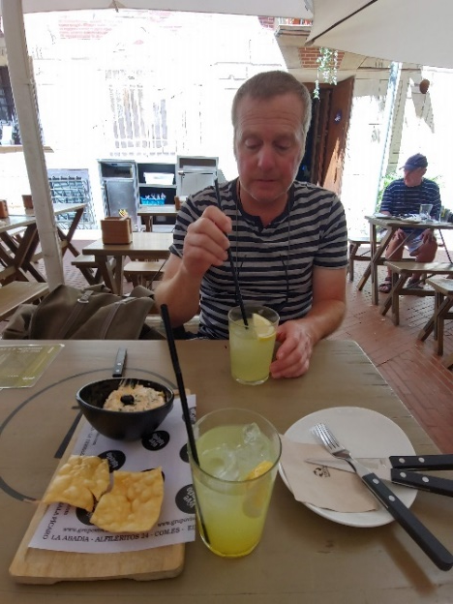
Global Issues – Fall 2022 Class Information
Hello and welcome to this class! Here is some basic information:
My name is Nelson Parish. Please call me “Nelson” or “Mr. Parish.”
Please don’t call me “Parish.” Also, please don’t laugh at my head in this
picture.
Contact:
Please email me with questions about the class, your grade/attendance, etc.
I’m at anparoikos@gmail.com. You can also leave messages for me on
E-Class, but I don’t check that as often, and sometimes the messages appear
hours after you’ve left them.
If you have a simple question, you can also call me at 010-2867-0341. If I don’t answer, please
send me a text. I’m also on What’s App and KakaoTalk.
Note: I generally have my phone off or on “Do Not Disturb” mode from 10:00 PM to
9:00 AM. If you call or text too late or too early, I probably won’t answer your message
very quickly. Please plan ahead if you have questions about homework, quizzes, tests,
etc.
This presentation and photo on this page copyright 2022 – Nelson Parish

Slide 2

Global Issues – Fall 2022 Materials Information – E-Class: Calendar and Lecture Resources
Good news! You don’t have to buy a book for this class! Instead, I will bring
materials to class and/or put them on E-Class for you to download before each
class. Every week, before you come to class, you should check E-Class’s
“Lecture Resources” section, which is below “Lecture Contents.”
I will also put the information we talk about today (in this PPT file) in
“Lecture Resources,” too. Please check it out if you need to refresh your
memory! If you don’t understand something, please ask me! It’s important
information, and I will not excuse students who say, “I didn’t see/understand
it!”
Next week (by Friday evening, Sept. 9th), go to E-Class’s “Calendar” and
look at our class schedule. It will show you what I plan to do
every day, when homework is due, when tests and holidays
are, etc., for the next few weeks. Please look at it weekly,
preferably every Thursday night at the latest. I will update
and add to it as necessary at least once a week.
Asking questions is a strength, not a weakness.
This presentation copyright 2022 – Nelson Parish
Hand: http://www.thewisejobsearch.com/2013/06/no-questions-no-results-in-your.html

Slide 3
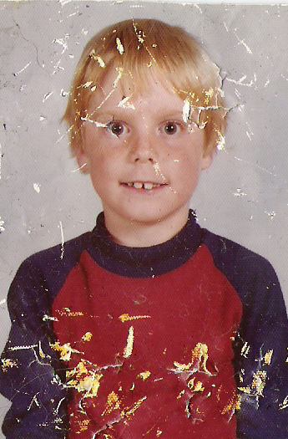
Global Issues – Fall 2022 Materials Information – E-Class’s Lecture Contents
Even more good news! Global Issues is now a three-credit
course! Yay! You get three hours of Mr. Parish per week instead
of the traditional two hours!
Sadly, you will not see me in the classroom for three hours a
week, so you’ll just have to go home and stare at this picture
instead.
We will meet for two hours every Friday. The other hour is a
25-minute lecture you’ll have to watch every week. At the end of the pre-recorded
Zoom lecture is an assignment. On average, each assignment will take at least 50
minutes, and probably more. You will have to complete seven (7) of the 13
assignments I give you this semester.
Important! Whether or not you do an assignment for a lecture, you must still
watch the lecture! If you don’t, E-Class will automatically count you absent.
I will put a weekly Zoom lecture on E-Class “Lecture Contents” every Friday
morning at the latest. You will have about a week to watch the assignment from
the “Assignments” section and turn in your assignment.
This presentation and photo on this slide copyright 2022 – Nelson Parish

Slide 4
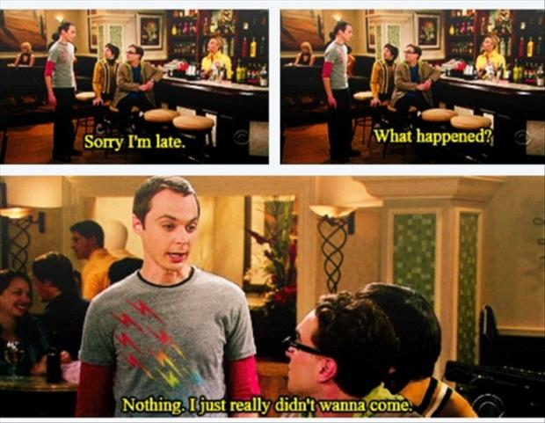
Global Issues – Fall 2022 – Grading Scheme
Attendance (10%)
Action/Event | Result
You are late (지각) three (3) times. | 1 absence (결석)
You leave early (조퇴) three (3) times with no explanation. | 1 absence
Your previous or next class is far away, or you have a professor that always lets you out late, so you often arrive late or leave early. | Tell me by next week, and I will excuse reasonable lateness/early leaving.
You are five minutes late to class. | OK – no 지각!
You are 20 or more minutes late to class. | 1 absence
You are absent in 15 or more class hours (including pre-recorded Zoom lectures). | “F” in the class
You are sick, have an official DSU event, military duty, etc. | No absence if you give me an excuse note. By DSU rules, you must give me a piece of paper or a scan of one as an excuse note – no texts, etc.
You are absent on a test or quiz day. | You’ll get “0” on the test/quiz unless you have an excuse note.
The weather is bad (typhoon, snowstorm, etc.). | Be safe! I won’t count you late. If you live far from campus and can’t come to class safely, text me. I will TRY to excuse your absence (if DSU allows me to).
As the semester goes on, I might have to change attendance policy or make exceptions for students in special
situations. If you have a special situation, please tell me as soon as you can. After you get your final grade at the
end of the semester, it’s too late to tell me! Let’s try to solve our problems early when it’s easier. Keep me
informed!
This presentation copyright 2022 – Nelson Parish
Big Bang: http://www.dumpaday.com/funny-pictures/funny-pictures-of-the-day-45-pics-3/attachment/funny-big-bang-theory-sorry-i-am-late-sheldon-cooper-quotes/

Slide 5
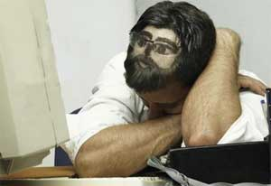
Global Issues – Fall 2022 – Grading Scheme
Participation or “Learning Attitude” (태도) (20%)
This is a discussion class, so we will do a lot of speaking activities. I expect you to participate actively when I ask you to. It’s also important because I think you’ll learn a lot more by talking to your classmates than you will by listening to me!
In almost every class hour, I will assign each of you from 0 to 3 participation points.
Most students who get A+, A, and B+ grades are active in class, too.
Points | Reasons
0 participation points for that class hour | 1. You sleep in class, even for a little while. 2. You use your cell phone in class without my permission – texting, playing games, etc. 3. You forget any class materials I ask you to bring (Maybe once is OK, but don’t do it too often.). 4. You sit alone and don’t talk to other students when I ask you to. 5. You don’t speak in English when I ask you to. 6. You are rude to other students or me, including talking while I’m talking, reading a novel or comic during class, insulting others, etc.
1 participation point for that class hour | You come to class with any class materials I ask you to bring and do what I tell you to do – no extra.
2 or 3 participation points for that class hour | 1. You ask questions in class. 2. You answer questions in class (when no one else does). 3. You help other students (e.g., invite a shy 혼자 student to talk, share your materials with students who forgot theirs, etc.).
This presentation copyright 2022 – Nelson Parish
Sleeping: https://www.hivehealthmedia.com/10-tips-good-nights-sleep/

Slide 6

Global Issues – Fall 2022 – Grading Scheme
Homework (10%) – Pre-Recorded Lecture Assignments
Action/Event | Result
You turn in HW one (1) day late with no excuse. | You get -10% on that assignment’s grade.
You turn in HW two (2) days late with no excuse. | You get -20% on that assignment’s grade.
You turn in HW three (3) days late with no excuse. | You get -30% on that assignment’s grade.
You turn in HW four (4) days late with no excuse. | You get -40% on that assignment’s grade.
You turn in HW five (5) or more days late with no excuse. | You get -50% on that assignment’s grade.
You want to turn in HW late with an excuse note. | Contact me by text as soon as possible! I will tell you how and when to turn in your HW. You lose 10% of your HW grade every day it’s late!
You cheat by copying from another student. | Both students will get “0” on any answer that is copied.
I will give you 13 homework (AKA “HW”)
assignments this semester. You choose seven (7)
of them. Please do all seven assignments!
Students who skip one or two assignments
often get C’s, and those who skip more often
get D’s or F’s.
You CANNOT do eight or more assignments
to get extra points or replace a bad HW grade.
Be sure you try hard on each assignment. If
an assignment is too difficult or boring, or if
you’re too busy to do it that week, then wait
for other assignments.
I don’t have time to regrade poorly done
assignments, but I am happy to answer
questions about your HW as you’re doing it!
Your first HW assignment is already
online! Watch the pre-recorded Zoom video
in E-Class’s
“Lecture
Contents.” You
can do the
assignment at the
end of the lesson
if you want to.
It’s due via email
by 11:59 PM on
Friday, Sept. 9th.
This presentation copyright 2022 – Nelson Parish
Homework?!: https://www.roblox.com/library/112193351/what-homework-funny-animal-picture

Slide 7
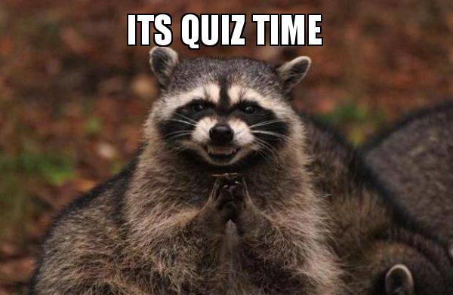
Global Issues – Fall 2022 – Grading Scheme
Quizzes (10%)
I hope there will be two (2) written quizzes, each worth 5% of your grade. I will tell you more about the quizzes later as I’m not sure what form they will be yet, but they generally won’t take more than 20 minutes.
Action/Event | Result
You are absent with no excuse on a quiz day. | You get “0” on that quiz.
You are absent with an excuse note on a quiz day. | You probably cannot take the quiz, but your grade on the other quiz will be used for both quizzes.
You cheat on a quiz. | You will get “0” on the quiz, as will anyone who helped you cheat.
This presentation copyright 2022 – Nelson Parish
Quiz time: https://makeameme.org/meme/its-quiz-time-xmgn4d

Slide 8
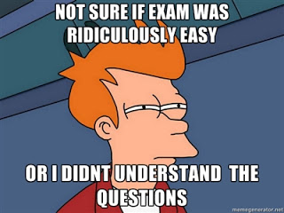
Global Issues – Fall 2022 – Grading Scheme Tests (50%)
There will be two (2) written tests. The midterm is worth 20% of your grade, and the final exam is worth 30%. I will give you more information about the exams later.
Action/Event | Result
You are absent with no excuse on a test day. | You get “0” on that test.
You are absent with an excuse note on a test day. | You probably cannot take the test, but your grade on the other test will be used for both tests.
You cheat on a test by talking to or copying from another student. | Both students will get “0” on the test.
This presentation copyright 2022 – Nelson Parish
Not sure…: http://hannahthien.blogspot.com/2012/06/in-midst-of-heat.html

Slide 9
Global Issues – Fall 2022 – Curves 1
I use a standard university curve on all grades in this class except attendance. Thus, for participation, homework, quiz, and test grades, I’ll curve the class average to 80%.
For example, if the class average on a test is 70%, the test was too difficult. Everyone’s grade will go up by about 14% (10/70 = 14%) to meet the 80% (average) curve. If the average grade on a test is 90%, the test was too easy. Thus, everyone’s test grade will go down by about 11% (10/90 = 11%) to meet the 80% average.
This presentation and graph on this slide copyright 2022 – Nelson Parish

Slide 10
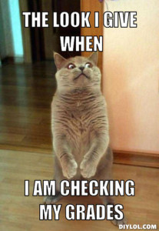
Global Issues – Fall 2022 – Curves 2
DSU usually requires me to use the absolute curve for this class. That’s good news and bad news. The
good news is that I can give as many A’s, B’s, F’s, etc., as I want to as long as they are supported by the
grading numbers (test scores, quiz scores, etc.). I’m not limited to giving, for example, only five (5) A’s like
I am in some of DSU’s “relative curve” courses.
The bad news is that I have less flexibility to “help” you if you are on the borderline between, say, an A
and a B+ or an F and a D. Under the relative curve system (0 to 30% A/A+, 0 to 40% B/B+, etc.) that DSU
follows for some courses, I can, for example, change the grade range so that a 58% is a D, not an F.
However, under the absolute curve we’ll be using, I’m required to follow these grade ranges:
A+ = 95 to 100%
A = 90 to 94%
B+ = 85 to 89%
B = 80 to 84%
C+ = 75 to 79%
C = 70 to 74%
D+ = 65 to 69%
D = 60 to 64%
F = 0 to 59%
Thus, if you don’t do homework on time, don’t study for tests, etc., and get a 58%, there is NOTHING I
can do to help you. I can’t change the grade range at all. Don’t be one of those sad cases of a student who
is lazy and fails this course by a mere 2%! Study hard! Do your homework! Keep up with the class!
This presentation copyright 2022 – Nelson Parish
Checking grades: http://3844s15.tracigardner.com/

Slide 11
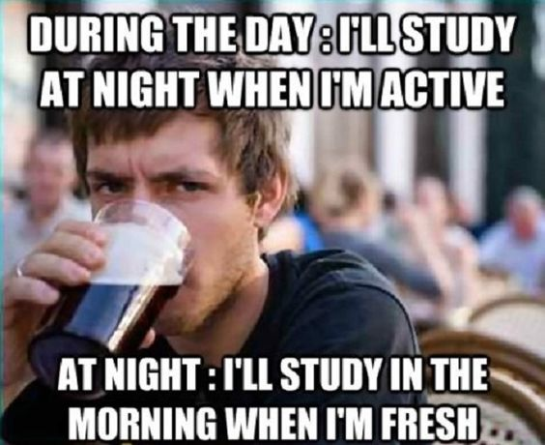
Global Issues – Fall 2022 – Warning!
Every semester that I’ve taught this course, the same thing has happened. A student is not diligent,
doesn’t do homework, misses quizzes, etc. Then, they see their final grade and are disappointed by it.
Only then do they start to care about their grade!
They suddenly feel very diligent and spring into action! “Mr. Parish, is there any extra credit work I can
do in the next day or two to help me get a higher grade? Please! Please! I need a higher grade! If I don’t
get one, something horrible will happen to me!”
I absolutely hate this type of behavior. It is the worst that a young adult university student can exhibit.
Not only is this childish, but it’s rather offensive considering the amount of work most students and I
put into this course. I give you many chances to choose your homework assignments, and I am available
many hours per day to help you with your questions. Suddenly, after a hard semester of long work, you
want me to give you an assignment and grade it really quickly at one of the times of the year that I’m
busiest? How rude!
In addition, it would be quite unethical for me to give you such
a chance without offering it to all of the other students in the
class. Do you think I want to grade 10 or 20 extra credit projects
on the last day of final grades? Nope!
If you ask me to do this at the end of the semester, I will simply
email you this page.
Please – Keep me informed of your troubles in this class, ask
questions, and help us solve problems early!
This presentation copyright 2022 – Nelson Parish
Lazy student: https://www.pinterest.co.kr/pin/425660602253691491/

Slide 12
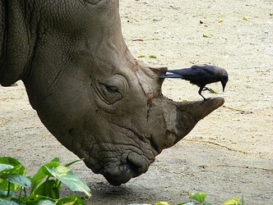
Global Issues – Fall 2022
Our Duties
My job:
1) Let you know about our schedule and what you need to do for
assignments, tests, etc.
2) Answer your questions about your attendance, assignments,
and grades as well as I can.
3) Give you feedback on your assignments and tests as quickly
and clearly as possible.
4) Notify you of changes in class policy, the schedule, etc., as
quickly as possible.
5) Offer you the opportunity to learn as much as you can.
Your job:
1) Ask me questions about our schedule, and what you need to do for assignments, tests, etc.
2) Ask me questions about the schedule, your attendance, assignment grades, etc., when you have them.
3) Ask me questions about feedback on your assignments and tests when you have them.
4) Check E-Class at least once a week so you know what’s happening in class and what is required from you (“I didn’t know,” is no excuse!).
5) Use every opportunity to learn as much as you can in this class.
This presentation copyright 2022 – Nelson Parish
Rhino and bird: https://ecosystemsbymanuela.weebly.com/mutualism.html

Slide 13
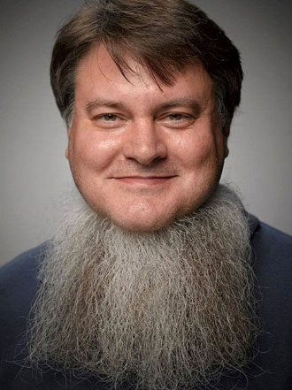

Global Issues – Fall 2022 ID Card
Name:
(You can write in English or 한글, русский алфавит, Español, chữ
Quốc ngữ, Oʻzbekcha, , etc.)
Class nickname:
(What do you want me to call you in class? Choose any name –
Korean, English, Chinese, Portuguese, etc.)
Student #: (학번)
Year: (학년)
Major:
(If you’re a double major, please write both majors.)
Cell phone:
Email:
Picture
These ID cards will make it easier for me to get to know you. They will also help me keep track of your participation, homework, etc., more easily.
This presentation copyright 2022 – Nelson Parish
Beard: https://faxo.com/no-shave-november-neck-beard-gross-59660

